Slide 1
A Project Presentetrion On
Online Clothes Selling FAMMS

Slide 2
Introduction
Online clothes ordering is a process of ordering clothes from a local variety or premium Quality through a web page or app. Much like ordering consumer goods online, many of these allow customers to keep accounts with them in order to make frequent ordering convenience

Slide 3
Objective
Online clothes ordering is a process of ordering clothes, and shoes, from a local variety or premium Quality through a web page or app. Much like ordering consumer goods online, many of these allow customers to keep accounts with them in order to make frequent ordering convenient

Slide 4
Project Category
Project Category: "Culinary Fusion: Exploring, Creating, and Sharing Flavors Online"
This project category emphasizes the website's role in bringing together a diverse range of culinary experiences, from exploring global flavors to creating delicious recipes and sharing the joy of clothes product with a worldwide community. It highlights the fusion of technology and gastronomy to create a unique online culinary destination.

Slide 5
Tools/Plateforam Hardware & Software
Web server: This is the computer that will store your website's files and serve them to visitors. You can either rent a web server from a hosting provider or set up your own web server.
Domain name: This is the address of your website on the internet. You can purchase a domain name from a domain registrar.
Content management system (CMS): This is a software application that makes it easy to create and manage your website's content. Popular CMS platforms include WordPress, Drupal, and Joomla.

Slide 6
Proposed System Description
Fashion & Clothes Database
The recipe database will be the centerpiece of the website. It will feature a wide variety of clothes from all over the world, covering all types of cuisine. fashion clothes will be searchable by ingredient, cuisine, and occasion. Users will also be able to create their own brand Quality accounts and submit their own brand of clothes to the database.
Brand Of Directory
The brand of clothes FAMMS website directory will allow users to search for New fashion design & Brand Quality by cuisine, location, and other criteria. Each Brand of listing will include information such as the clothes's & fashion type, contact information, and reviews from other users.

Slide 7
Moduale Description
Module 1: Introduction
Welcome and introductions
Overview of the clothes veriety website
Target audience and goals
Module 2: Features
Comprehensive shoes database
Premium Quality clothes
Local clothes
Other features (if applicable)

Slide 8
Scope Of The Project
Here are some things to include in the Scope of the Project section of your presentation:
The target audience for your website.
The purpose of your website.
The key features and functionality of your website.
The timeline for completing the project.
The budget for the project.
If you are presenting to a group of investors, you will want to focus on the business aspects of your project, such as the target market, the revenue model, and the competitive landscape. If you are presenting to a group of technical experts, you will want to focus on the technical aspects of your project, such as the architecture, the database, and the programming languages used of your project and then exceed expectations th

Slide 9
Further Enhancement O The Project
Add a clothes type section. People love to watch design of T-shirt, shoes, women clothes, etc.., especially when it comes to Brand of FAMMS. You could create Design of clothes of your type, Design & product reviews, or selling tips.
Add a social media integration. Allow users to share your design of Shirts, T-shit, & Shoes and blog posts on social media with just a few clicks. This will help you reach a wider audience and promote your website.
Add a community section. Create a forum or chat room where users can interact with each other and share their love of Design & product . This will help build a sense of community around your website.
Add a personalization feature. Allow users to create profiles and save their favorite Design & pattern and FAMMS Brand. This will make it easier for users to find the content they're looking for and to have a more personalized experience.
Add a monetization strategy. There are a number of ways to monetize a design of clothes & social media platform share in website, such as advertising, affiliate marketing, or selling digital products. Consider adding a monetization strategy to your website to generate additional revenue.

Slide 10
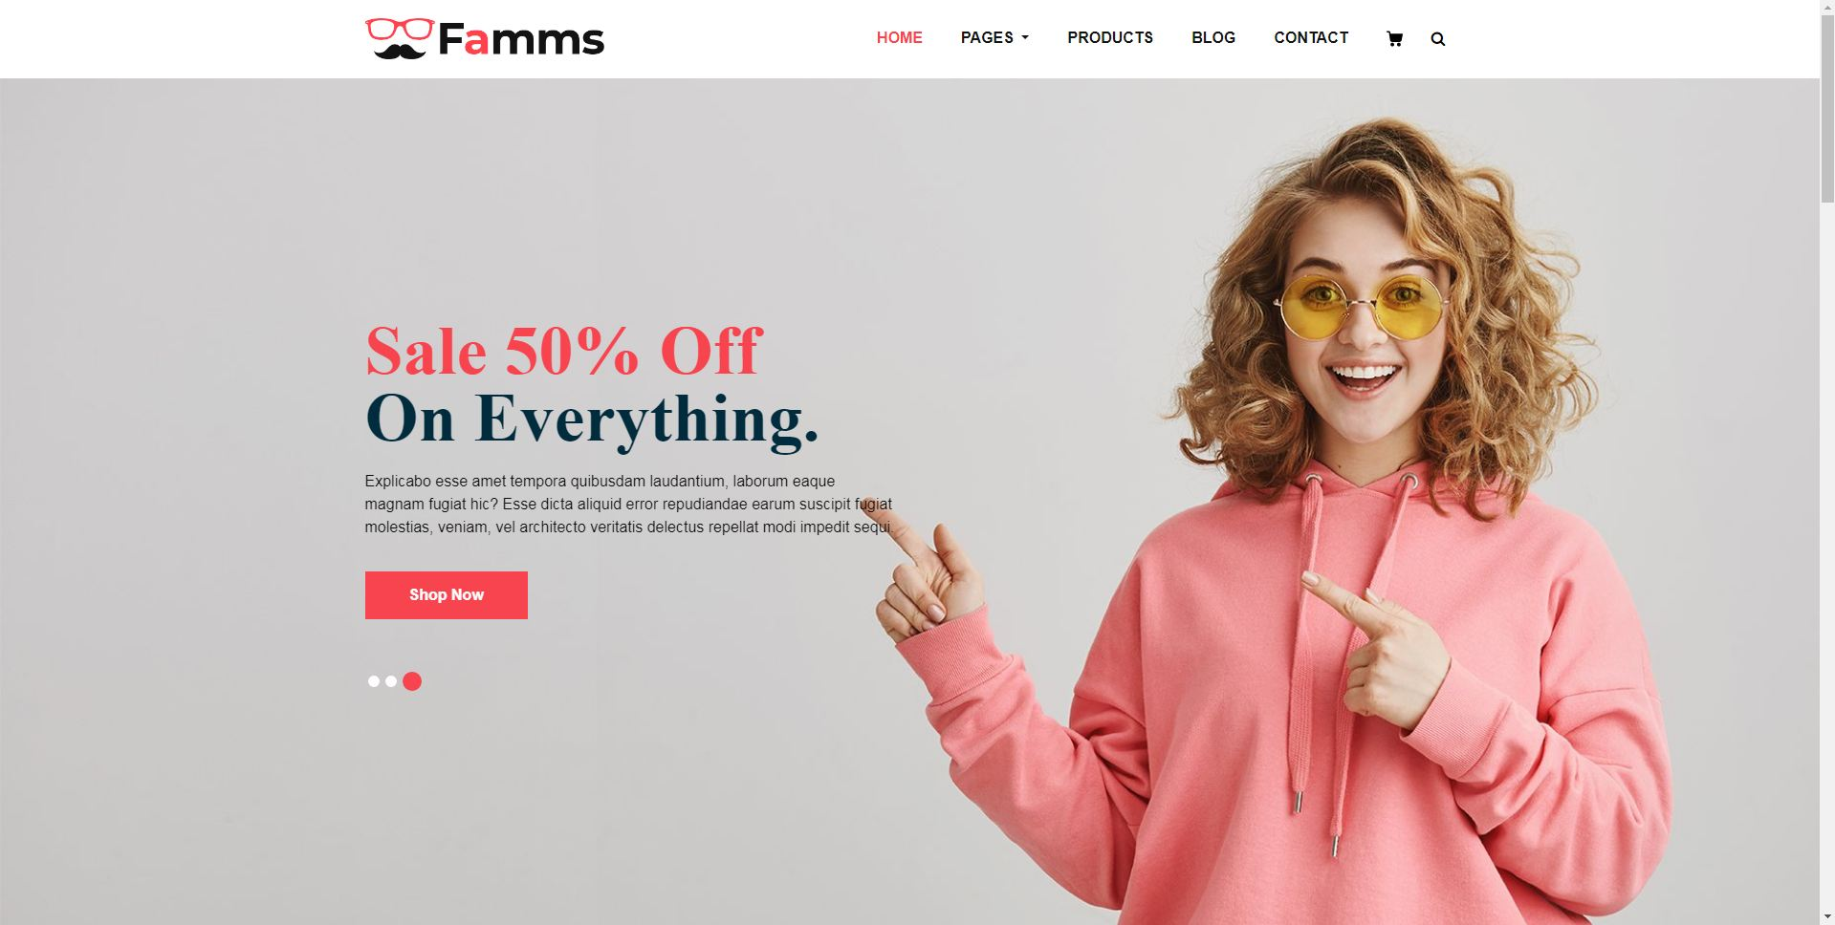
Home Page

Slide 11
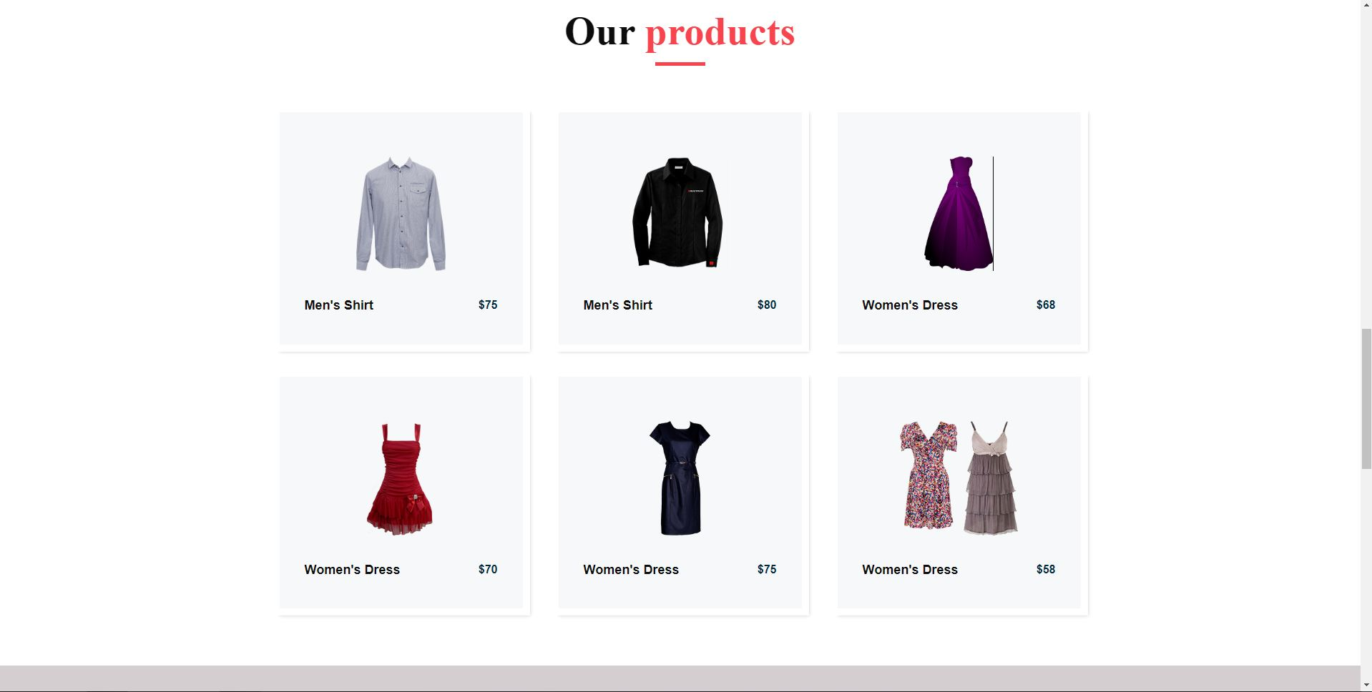
Menu & product Page

Slide 12
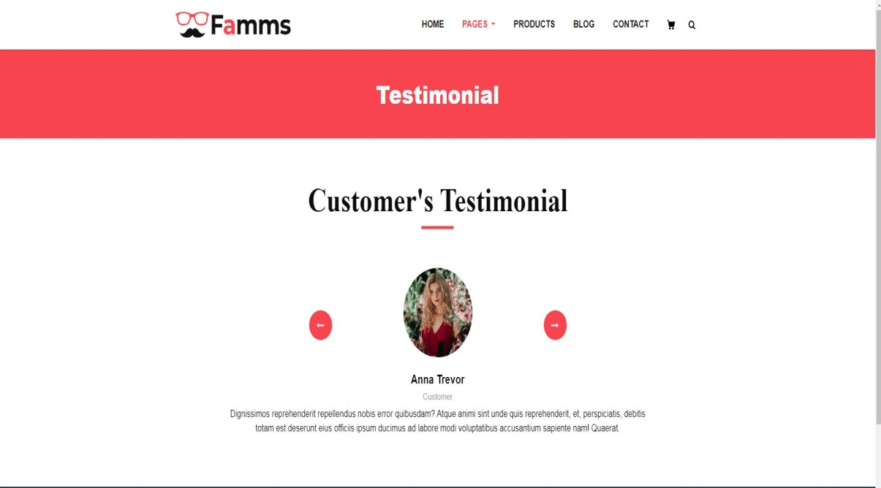
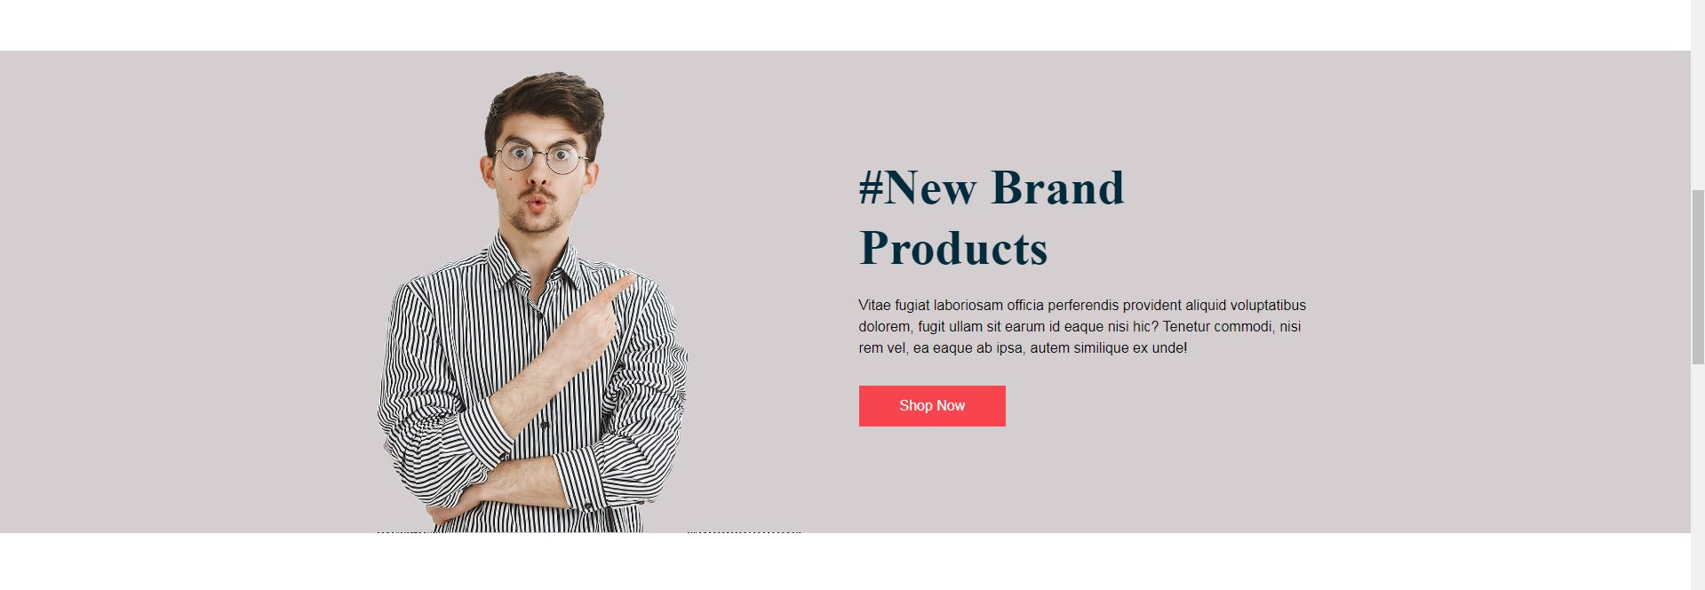

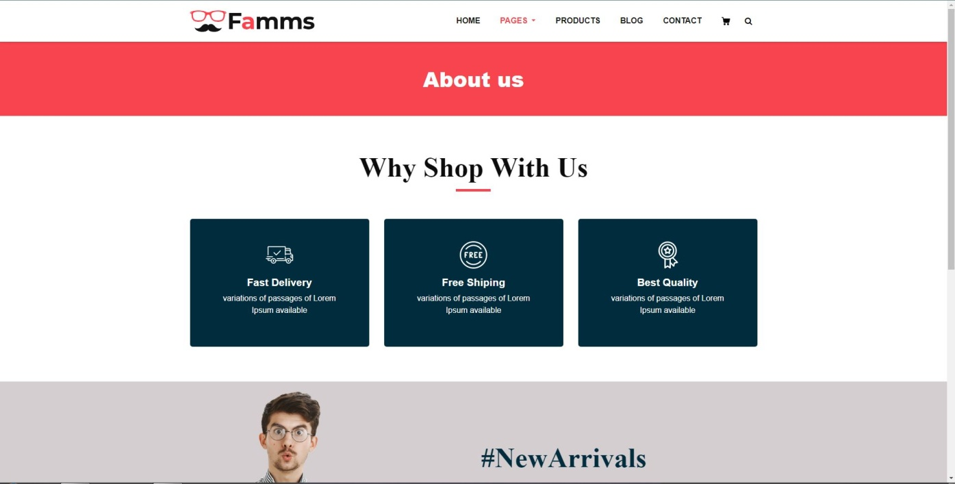
Other Menu Pages..

Slide 13
Thank You...

